Slide 1
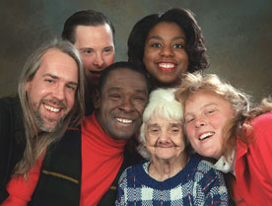
Promoting positive appropriate and responsive relationships with persons served and their families
FACILITATOR: Karen K. Wright, Master of SPED

Slide 2
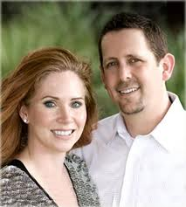
Welcome the family members
It is important to encourage the family members to be involved in the individual’s life.

Slide 3
Welcome family members
Make the family members feel at comfortable whenever they visit.

Slide 4

Welcome the family members
Ensure there is a signed ROI on file prior to releasing any information to the family.

Slide 5
Welcome the family members
Keep them abreast of all the latest involving the individual.
Such as, but not limited to:
Change in health condition
Change in services
Accomplishments
Achievements
Change in medication
Change in health service providers
Additional health service providers

Slide 6

Welcoming the family
Encourage the individual to contact the family if she or he has not heard from them for a while.

Slide 7
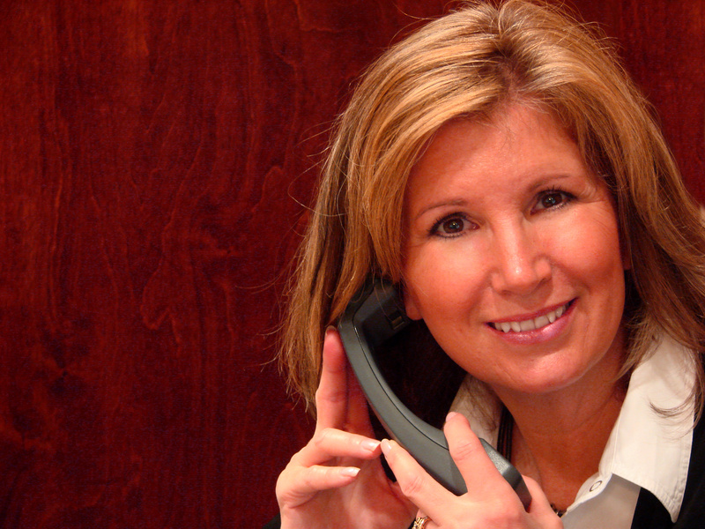
Welcoming the family
If the individual is non-oral, staff must call the family if the agency has not heard from the family in a period of time.
Make them aware that you are just checking that all is well.

Slide 8
Welcoming the family
Invite the family to the IEP meeting.

Slide 9
WELCOMING THE FAMILY
Make sure to ask the family if they have any concerns.

Slide 10
Welcoming the family
Be respectful of their concerns even if you do not think it is that important. Always be an empathetic listener.

Slide 11

Welcoming the family
Scenarios

Slide 12

Welcome the family
REMEMBER: The family is a part of the team and a positive relationship is important.

